Slide 1
Load Balancer
It basically distributes incoming traffic across multiple target in one or more AZ.
It increase High Availability & Fault Tolerance of applications.
LB is in front end (internet facing) & EC2 instances are in backend.
We can add or remove compute resources from LB as needs change.
By default, ELB distribute traffic evenly across defined AZ without considering number of instances available in each AZ.
Enable Cross Zone Load Balancing if you want to distribute traffic evenly across registered EC2 instances within AZ.
ELB name must be unique within an account.
ELB is region specific, so all registered EC2 instances must be in same region but may be in different AZ within that region.

Slide 2
Important terms need to understand :
I) Listener – It is virtual that checks for connection request.
- It is configured with a protocol & port number for connections from clients to LB (Frontend) as well LB to targets (Backend).
II) Target Group – It is group of EC2 instances where LB distribute traffic.
- Need to register with LB
III) Target – An individual EC2 instance within target group.
- It is based one of the below three :
> IP > Lambda > Instance
When target is IP based, use only these following CIDR
- 10.0.0.0/8 - 100.64.0.0/10
- 172.16.0.0/12 - 192.168.0.0/16
* You can not specify Public IP Address as target IP.

Slide 3
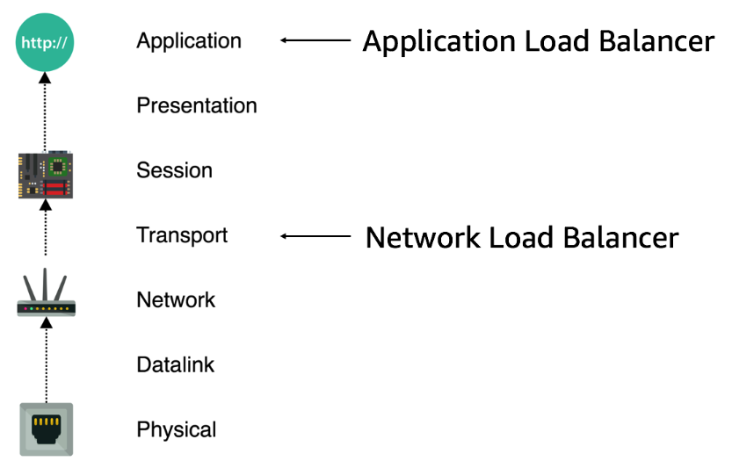
There are three types of load balancer :-
1. Application Load Balancer :
- Work on 7th layer of OSI model.
- Support HTTP & HTTPS
2. Network Load Balancer :
- Work on 4th layer of OSI model.
- Support TCP, UDP & TLS
3. Classic Load Balancer :
- Work on both 4th & 7th layer of OSI model.
- Support HTTP, HTTPS, TCP,UDP,TLS
- Not in use

Slide 4
We can configure health check to monitor the health of compute resources, so that LB send requests only to the healthy ones.
Health check ensure that request traffic is shifted away from a failed instance.
Default Interval Time = 30 sec
Range = 5 sec to 300 sec
Response Time-out = 5 sec
Unhealthy Threshold
An instance is declared unhealthy, if two consecutive health is failed.
Default = 2
Range = 2 – 10
Healthy Threshold
Number of successful health check before declaring healthy.
Default = 10
Range = 2 - 10

Slide 5
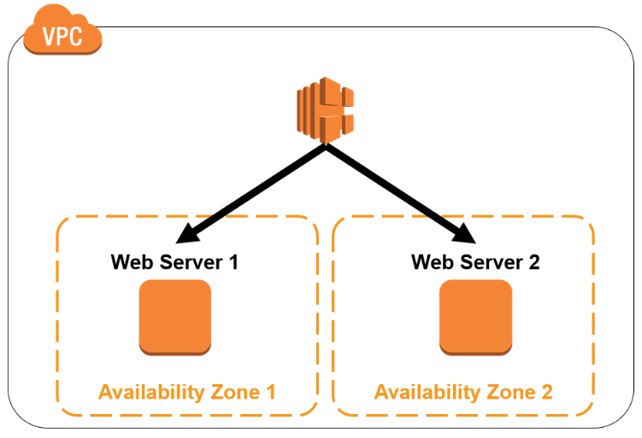
Lab1 : Application Load Balancer
Create two EC2 instance in different zone but within same VPC.
Install Web Server on both EC2.
Create Application Load Balancer
Copy ALB DNS name & open in browser.
Refresh, shuffle between server1 & server2.
- Delete LB.
- But TG & EC2 is not deleted, so delete one by one

Slide 6
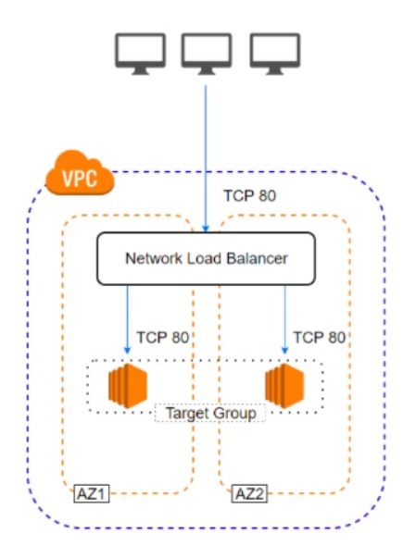
Lab2 : Network Load Balancer
Create two EC2 in two different AZ.
Install IIS on each EC2.
Create NLB.
Create target group
Copy DNS name of NLB from description
and open in browser.

